Slide 1
BEVI Authorized Administrator Training
Craig Shealy, PhD Kris Acheson-Clair, PhD Jennifer Wiley, EdD

Slide 2
Introductions
Let’s take a few moments to:
Make a note the most important thing you need to take away from the session and questions you need to have answered.
Introduce ourselves
Identify concerns and goals of the group
Notes:
Four groups of four, sticky paper and posting to keep the goals present, get to know each other---15 minutes

Slide 3
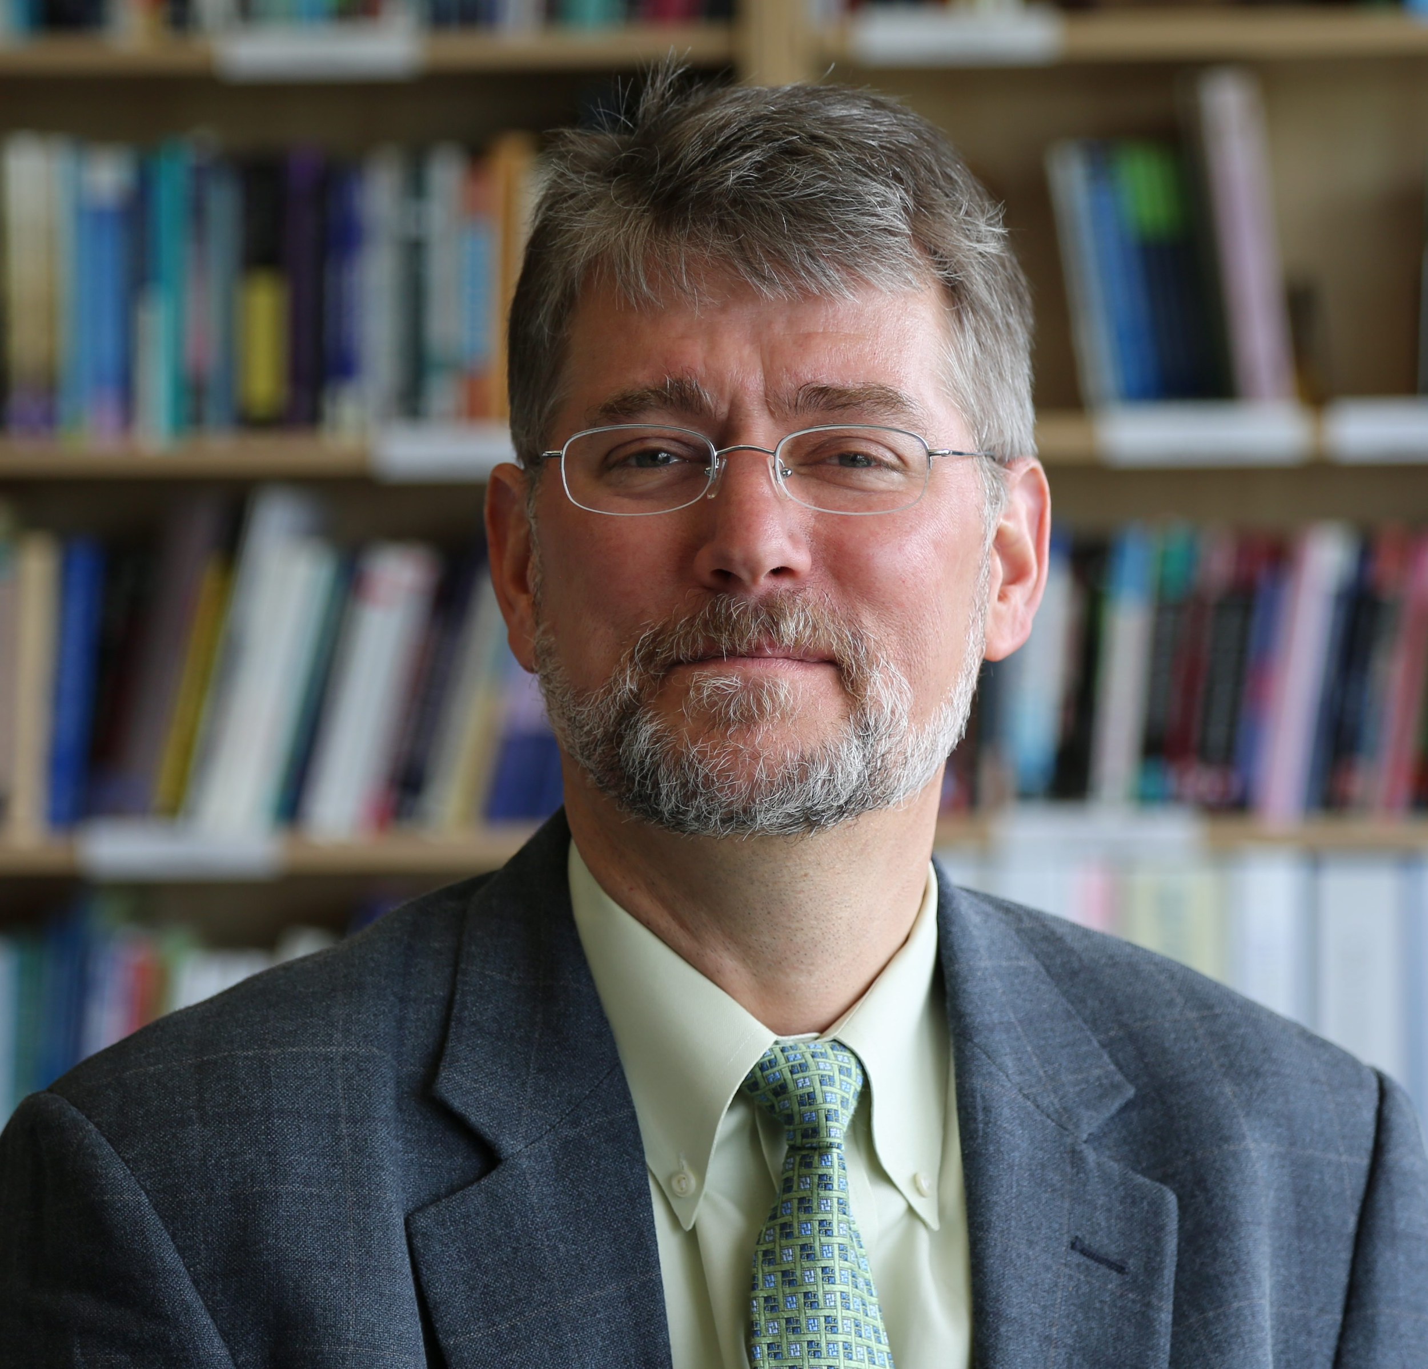
How the BEVI began
Notes:
Play clip of Craig describing the development of the BEVI.

Slide 4
Guided Practice
Group Debriefing Demonstration

Slide 5
Group Debriefing Demo
As I demonstrate sharing group results, I want you to practice metacognitive awareness of the following, for later discussion:
What language am I using to frame the results, and why?
Which parts of the group report am I highlighting, and why?
How do you see me paying attention to affect and caretaking for participants’ processing of results?

Slide 6
About the BEVI
•Created from authentic statements
•20+ years of demonstrated validity and reliability
•Often used
•as institutional profiles
•as a pre/post measure for curriculum or “high impact experiences” (study abroad, internships, practica)
•as a learning tool
•Yields very rich data – 17 scales and multiple sub-group comparisons

Slide 7
About the BEVI
•The scales of the BEVI provide rich data on who students are
•They can also show us the interaction between who people are and what they learn
•The instrument is neutral (but of course institutions and faculty are NOT)

Slide 8
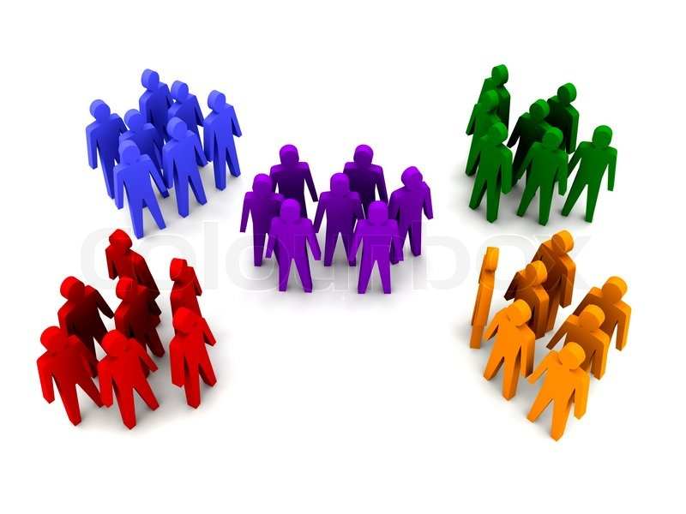
Beliefs, Events, & Values Inventory
The BEVI shows us how
GROUPS of people
are SIMILAR and DIFFERENT

Slide 9
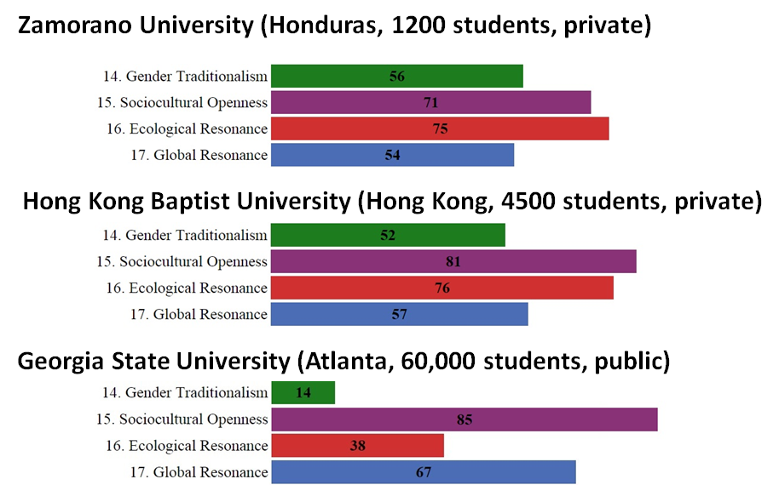

Slide 10
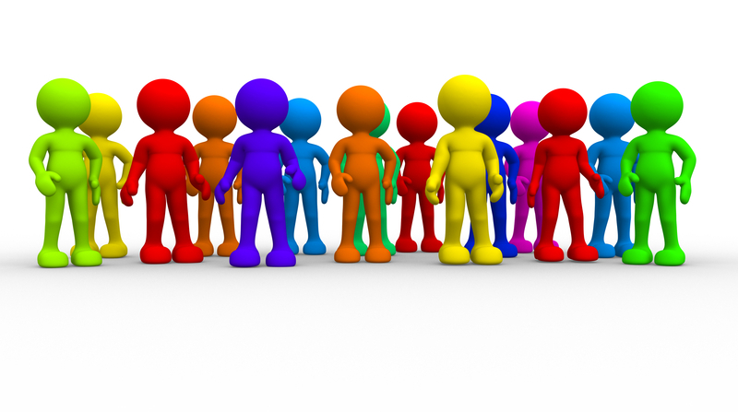
Beliefs, Events, & Values Inventory
The BEVI shows us the complex patterns of variation
WITHIN GROUPS

Slide 11
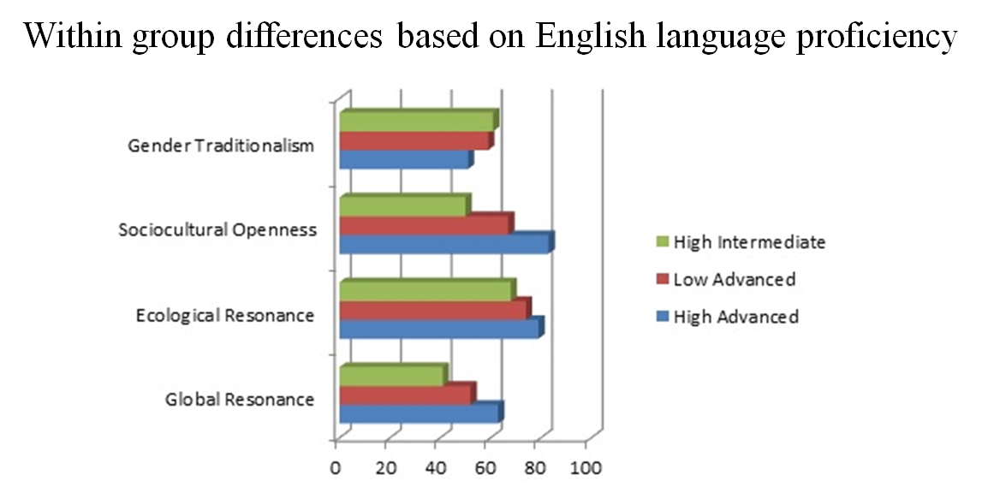

Slide 12
Beliefs, Events, & Values Inventory
And the BEVI can show us
how people grow and change
OVER TIME

Slide 13
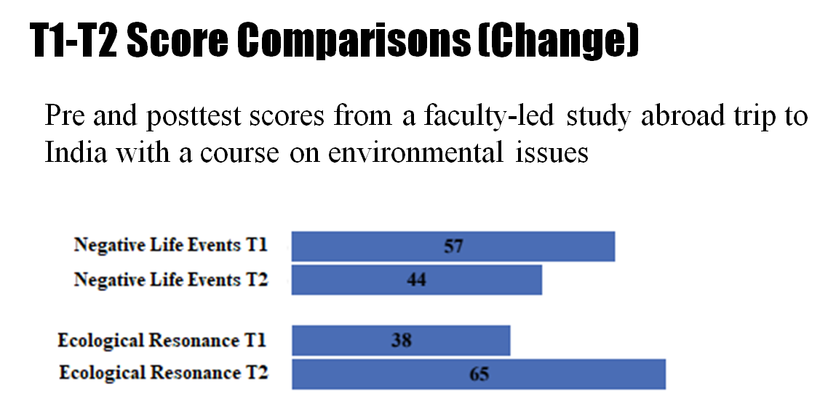

Slide 14
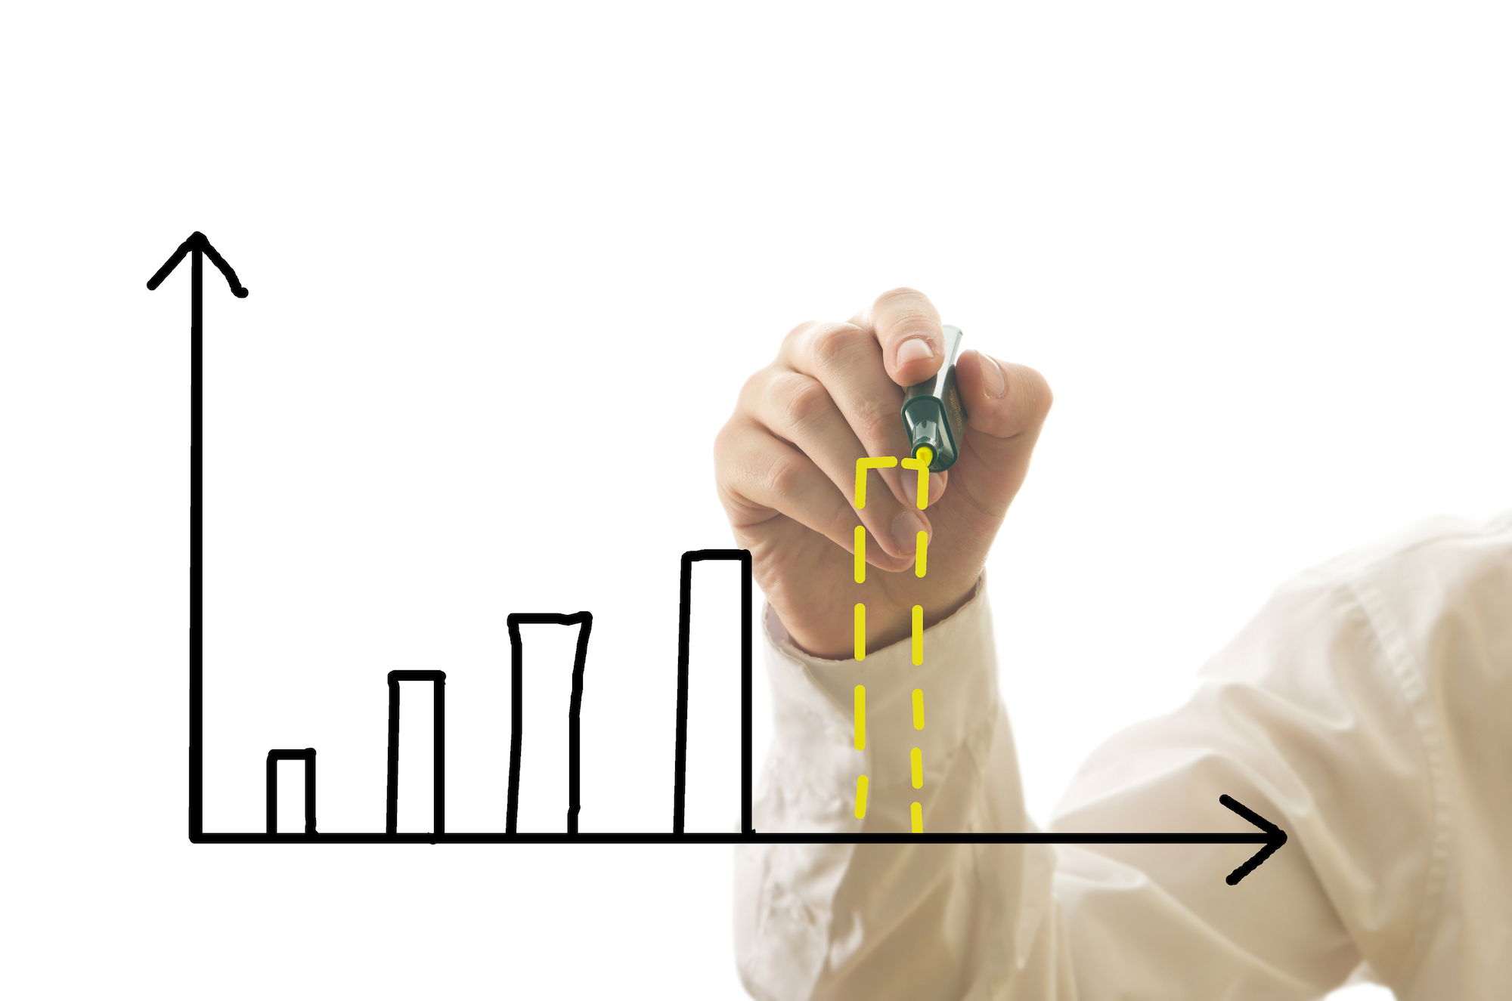
And now YOUR results!
Notes:
Potentially add screen shots from PDF of group report

Slide 15
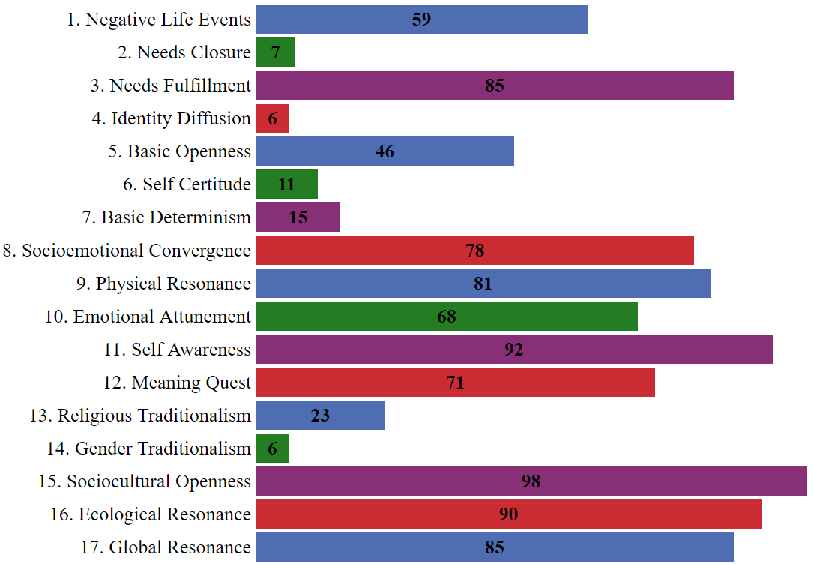
Aggregate Profile
Notes:
Potentially add screen shots from PDF of group report

Slide 16
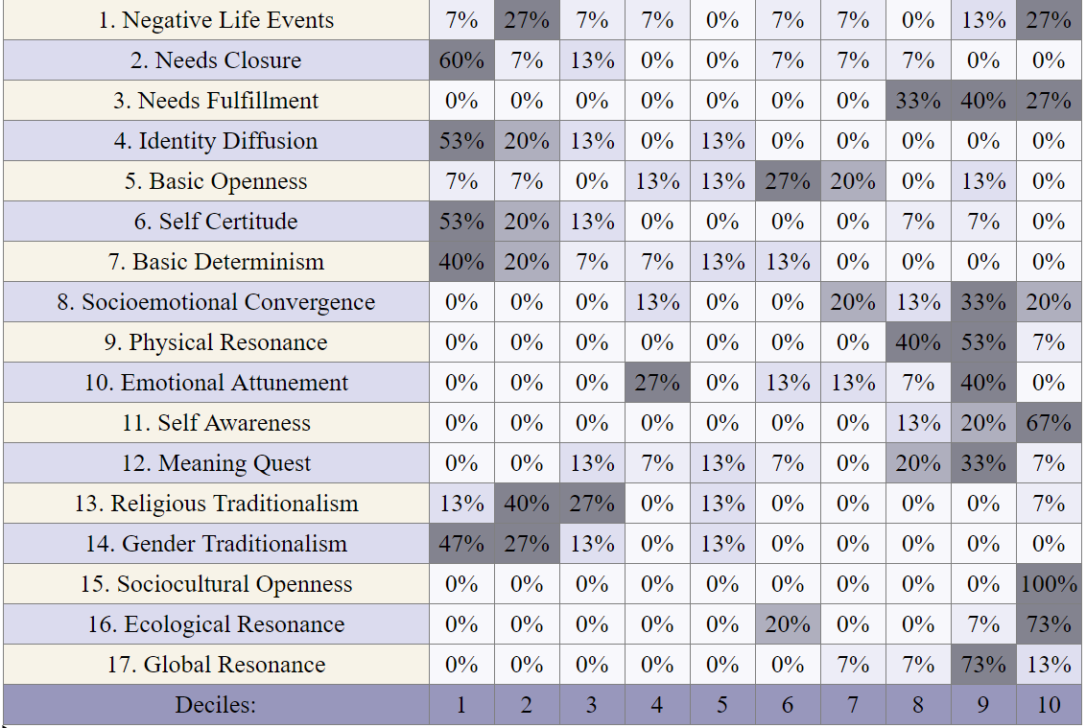
Decile Profile
Notes:
Potentially add screen shots from PDF of group report

Slide 17
Some Gender Differences
Most scales revealed no meaningful subgroup variation by gender, however...
Notes:
Potentially add screen shots from PDF of group report

Slide 18
Guided Practice
Group Debriefing Discussion

Slide 19
BEVI Debriefing
•What are you feeling right now (physically, emotionally)?
•Where do you see yourself fitting into this group (what similarities and differences do you now see between you and the people sitting next to you)?
•Which scales do you feel the strongest preference to score at one end or the other?
•What changes might you expect to see in these results over time?

Slide 20
Group Debriefing Analysis
PAIR/SHARE - Returning to your metacognitive task, what did you notice with regard to the following:
What language did I use to frame the results, and why?
Which parts of the group report did I highlight, and why?
How did you see me paying attention to affect and caretaking for participants’ processing of results?

Slide 21
Quick Break
Notes:
Give a restroom break--make this a longer break

Slide 22
Theoretical Foundations
Construct Definitions Equilintegration Theory Transformative Learning Theory

Slide 23
Much of this section is drawn from
Notes:
The theoretical basis for the BEVI is about understanding the processes through which humans shape their worldview as they seek to have their needs met.

Slide 24
To make sense of beliefs and values,
we need a working definition of
“belief,” “need,” and “self.”
These are constructs, any one of which may be
defined as “a concept or a mental representation
of shared attributes or characteristics, and it is
assumed to exist because it gives rise to
observable or measurable phenomena”
(Hubley & Zumbo, 2013, p. 3).

Slide 25
internalized versions of reality
influence and mediate experience
vary in cognitive complexity and affective intensity
empirically verifiable?
consciously accessible?
often verbalized as truths
typically related to other beliefs
exist in the service of core human needs
collected together, they form a value set

Slide 26
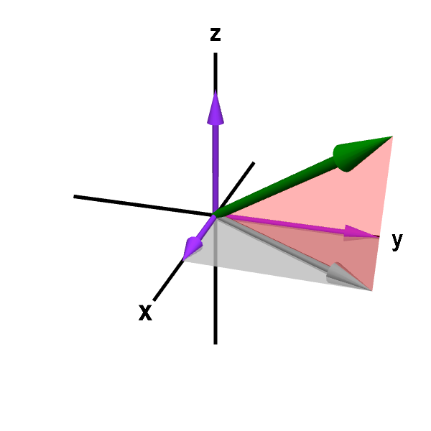
Four Dimensions of Belief
Favorability - considered good or bad?
Veracity - experienced as true or false?
Intensity - strongly or weakly held?
Congruency - consistent with other beliefs?

Slide 27
Continuum of Belief
If you want something done right you have to do it yourself.
Committed
Non-Committed
Certitude Investment Sympathy Equivocation Skepticism
Notes:
Need to have a clip of Craig here

Slide 28
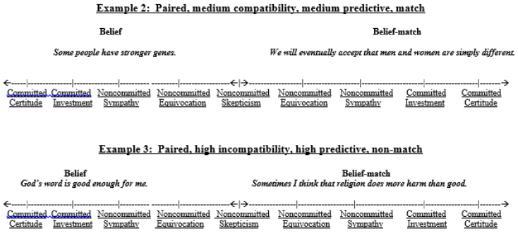
Continuum of Belief

Slide 29
One may hold many beliefs, and those which are held and maintained over time solidify into values. Beliefs are the building blocks of values and are, thus, fewer in number than beliefs (Feather, 1992; Rokeach, 1973; Shealy, 2016)
Standards of behavior and what is important in life (common vernacular)

Slide 30
humans are highly motivated to fulfill them
exist along a physical-psychological spectrum
derived from evolutionary adaptation and core to human existence (define us as a species)
expressed uniquely (individual adaptive potential)
interact with development and formative variables
are expressed both nonverbally and verbally

Slide 31
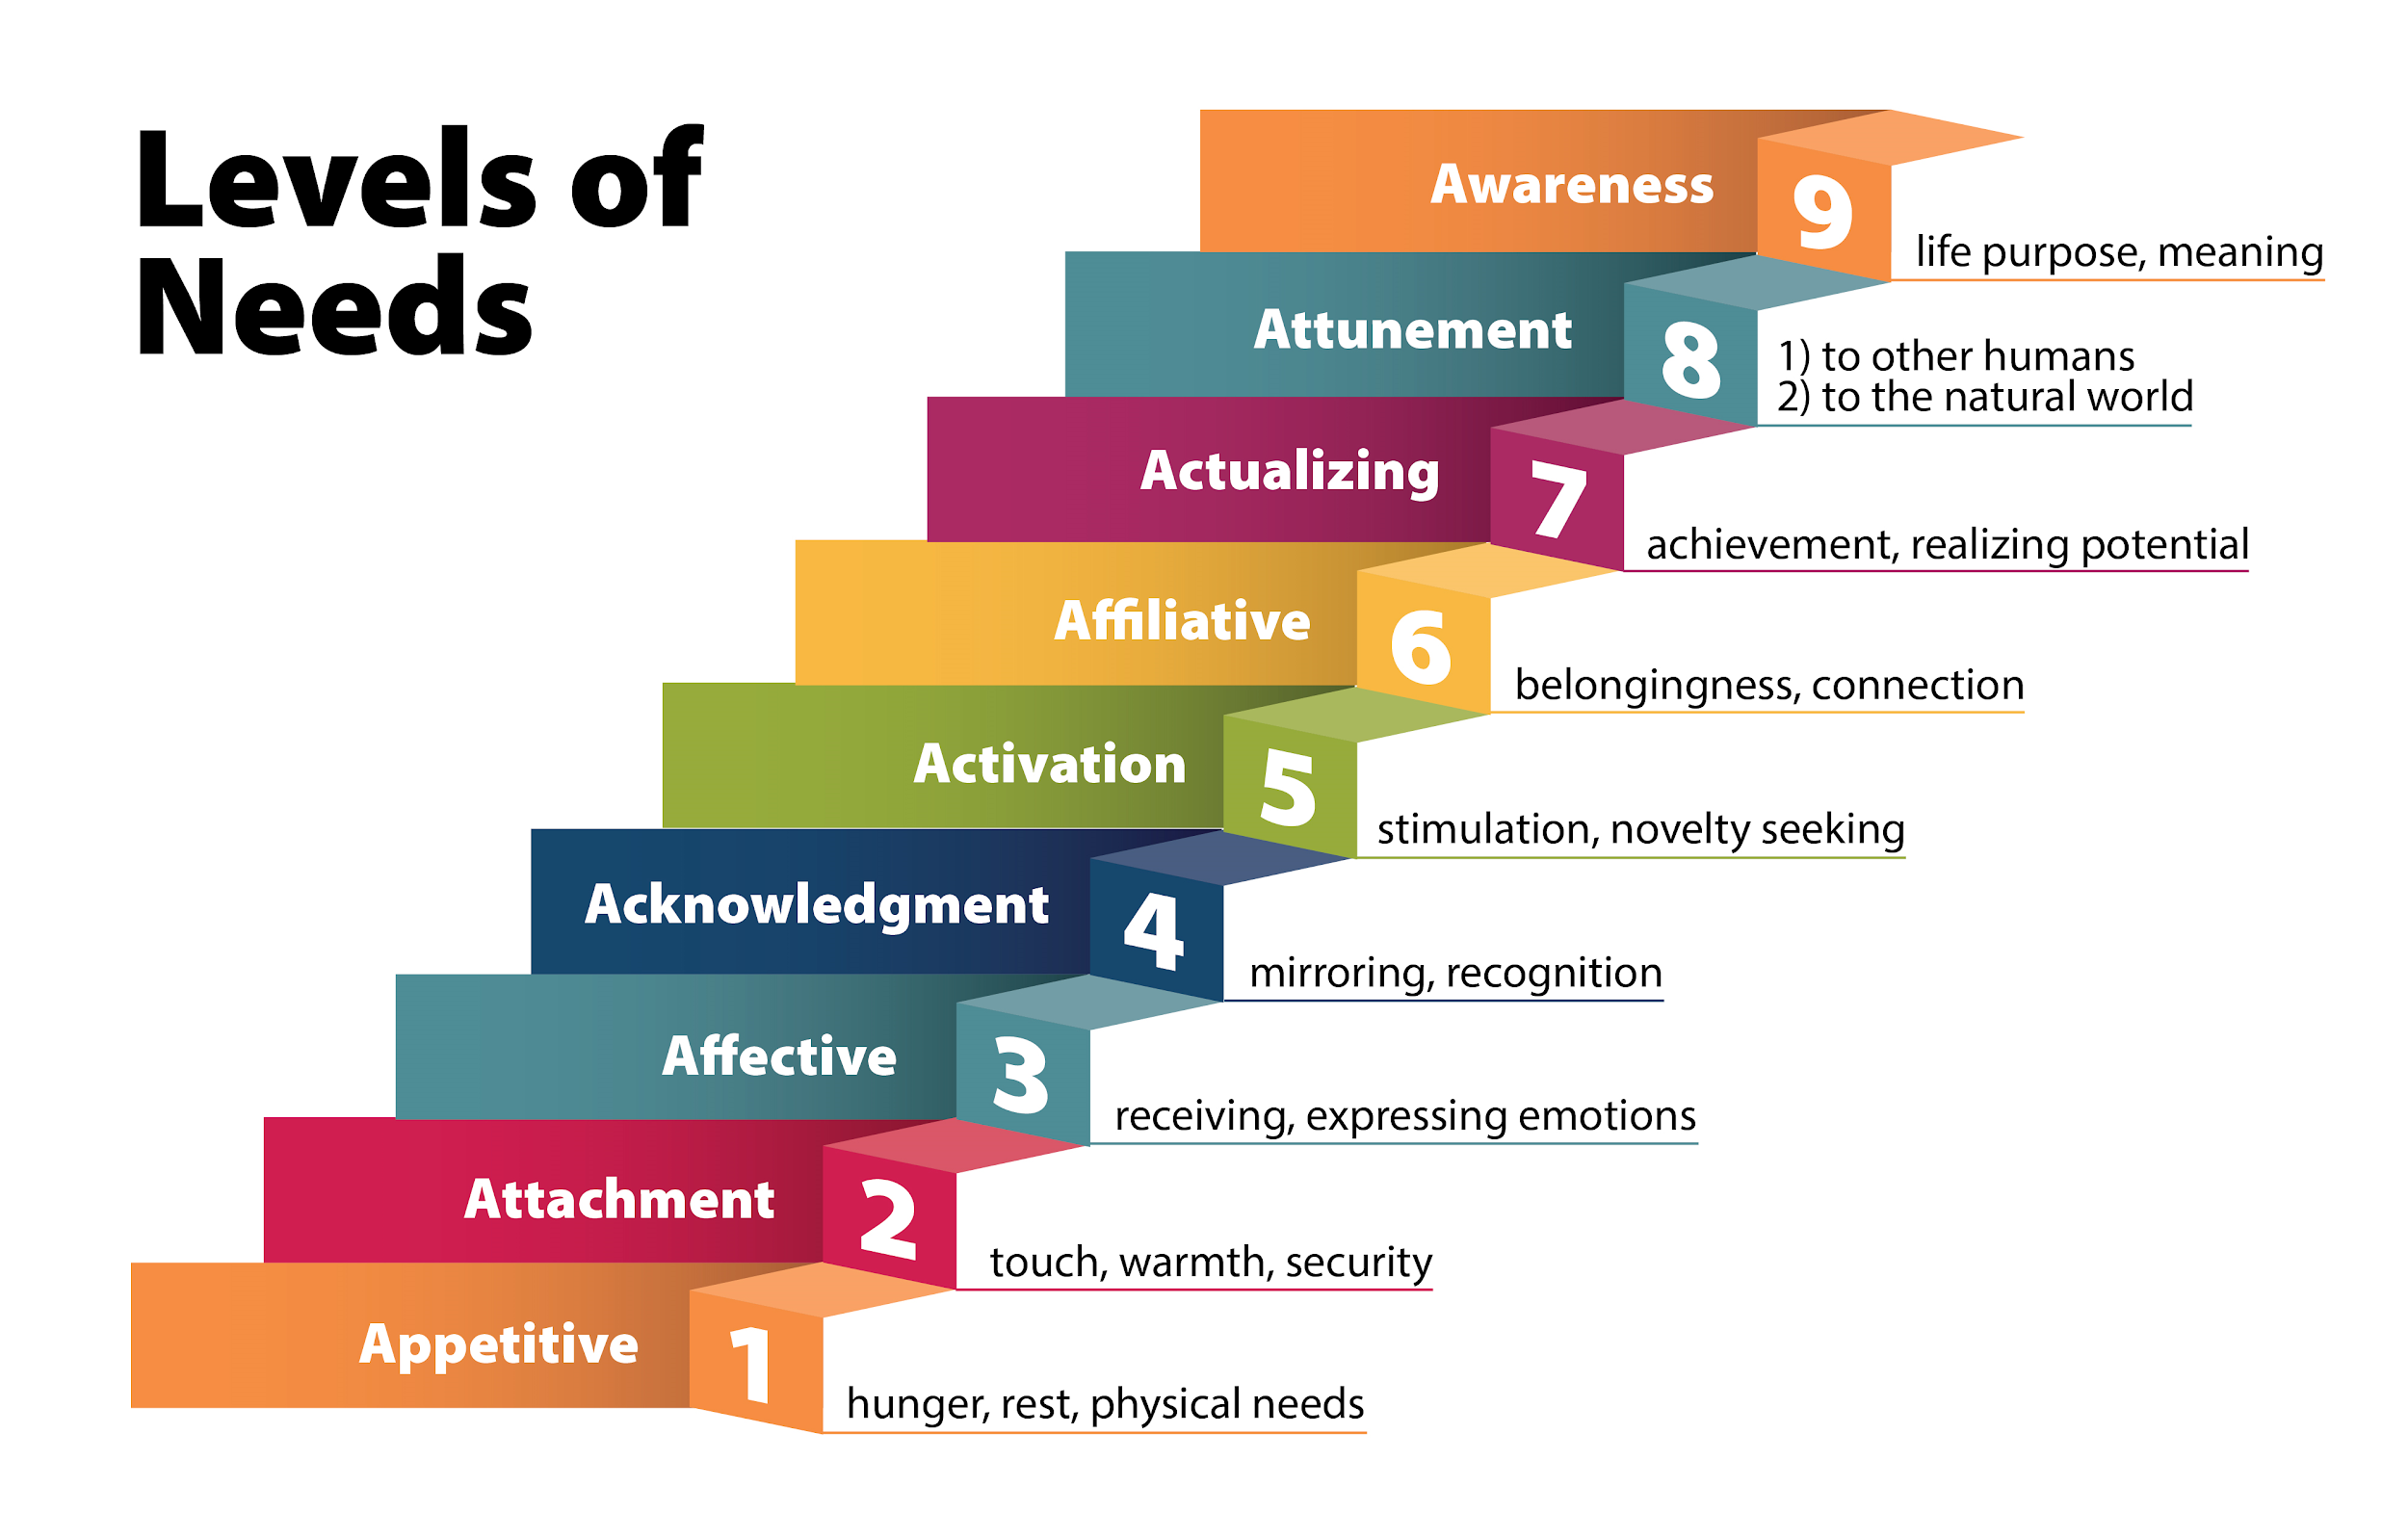

Slide 32
highly complex and interdependent system
derivative of our awareness of our own existence
experienced in both subjective (I) and objective (me) terms
encompasses and organizes all aspects of human experience and functioning

Slide 33
Notes:
Formative - the etiology and development of the self
Regulatory - the functioning and organization of the self
Contextual - the level of analysis at which the self is described and experienced
Perceptual - the self’s awareness of its own existence, structures, and functions
Experiential - the self is experienced both physically and metaphysically
Integrative - the extent to which individual components are integrated into a coherent gestalt

Slide 34
Brain Break

Slide 35
Equilintegration (EI) Theory
EI Theory explains the process through which humans construct a belief and values system by interacting with the world around them to get their needs met.

Slide 36
Beliefs and Values are:
the products of experience
impactful, even when not known or logical
make up the self
provide information about and access to the self
not easily modified
change other aspects of the self when they change

Slide 37
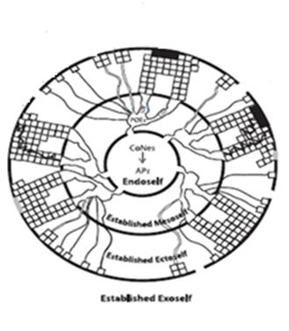
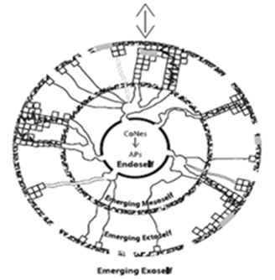
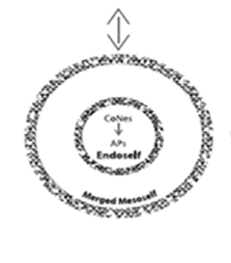
Development of the EI Self
Notes:
Example of little girl and parent at the pool--parent’s view of girl becomes the girl’s view of herself through “Oh, honey, you are a brave swimmer.”

Slide 38
Guided Practice
Applying EI Self Theory

Slide 39
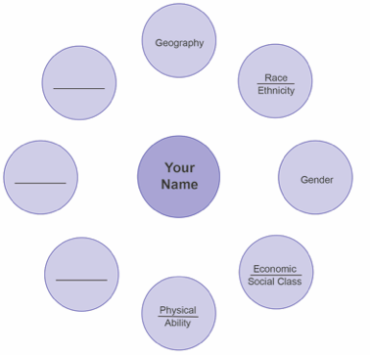
Source of Beliefs Structure:
Formative Variables
Step 1: Sketch a personal culture model like this one on a piece of paper. Take just a few minutes to think about fundamental facets of what makes you who you are. You don’t have to use these examples. Now, choose one facet to focus on in Step 2.

Slide 40
Source of Beliefs Structure:
Formative Variables
Education
Step 2: Think about all the environmental or contextual factors that play a role in this aspect of your identity. There are some examples on this slide but you can certainly add others. Now, choose one contextual factor to focus on in Step 3.
Family
Media
Gender
Friends
Workplace
Travel

Slide 41
Source of Beliefs Structure:
Formative Variables
High School: Males are athletes and focus of events, females are cheerleaders on sidelines
Step 3: Based on the facet you chose from the first step and the contextual factor from the second step, consider how conversations, memories of images or media, stories shared by family or friends may have impacted what you believe about this facet of yourself. See the graphic to the left for a model.
Elementary School: Scolded for being “unlady like” when climbing in a dress
High School: Male math teacher encouraged girls to learn math for science careers
Education
Middle School: Teased for slower physical development
Gender

Slide 42
Source of Beliefs Structure:
Formative Variables
Step 4: Put the examples you generated in Step 3 in the language of EI Theory.
What needs did you have?
How were those needs met or not met?
How did those experiences shape your beliefs and values?
Notes:
Model application of theory (like Craig’s example of the kid jumping in the pool) and then ask for participants to share their own examples.

Slide 43
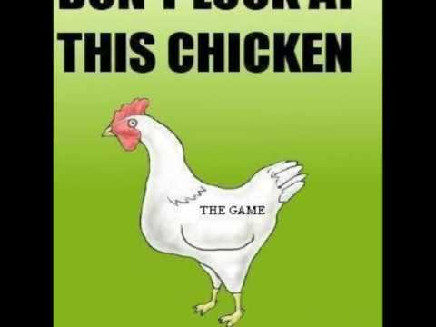
Break
Notes:
Professional Development Video (office style humor) https://www.youtube.com/watch?v=JZQey8ChJVU
Academic Advisor Spoof https://www.youtube.com/watch?v=HCqp1CqMq5w
Not meant to be funny, but it is hilarious https://www.ualberta.ca/science/science-news/2015/november/the-snunkoople-effect
Cat herder https://www.youtube.com/watch?v=m_MaJDK3VNE
Gilette Commercial--not funny but a conversation about how values are passed along https://www.youtube.com/watch?v=koPmuEyP3a0

Slide 44
Transformative Learning Theory
PAIR/SHARE:
1. What sets Transformative Learning apart from learning in general?
2. What are some situations you have been in, in which you think you have experienced transformative learning?
3. Can any change in a person be considered transformative learning?

Slide 45
To “Count” as Transformative Learning:
Engages core human needs to fulfill potential
Follows moments or processes of disequilibrium
Deep changes in structures/processes of the self, including beliefs and values
Experiential/observable changes in “optimal” directions (e.g., for the health of the self, the effectiveness of relationships, the good of society)
Makes the nonconscious conscious
Necessary prerequisites include
Conditions
Processes
Capacities
Notes:
Have to understand the reason people learn or not, reason people are bored, what is at the core of the self is not involved in the learning environment--not activating the core needs.

Slide 46
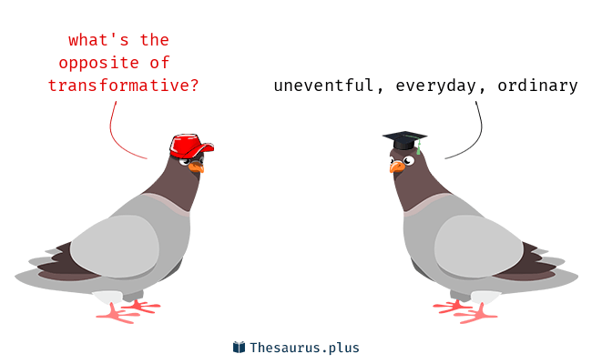
Transformative Learning Theory
What facets of a person change when an experience is transformative?
Ways of being
Ways of knowing
Sense of Self
Capacity
Sense of Other
Worldview

Slide 47
Guided Practice
Understanding
Transformative Learning

Slide 48
Let’s get Concrete
You have 1 minute to think,
and 1 minute to write:
What story can you tell about transformative learning that you have experienced or witnessed?
Be sure to consider the criteria we just discussed. (Is it really transformative learning according to TL Theory?)

Slide 49
BEVI Constructs
Making Sense of BEVI Scales and Domains

Slide 50
BEVI Overview www.thebevi.com
The BEVI seeks to understand "who the person is" prior to participating in an experience, "how the person changes" as a result of the experience, and how these factors interact to produce a greater or lesser likelihood of learning and growth – “who learns what and why, and under what circumstances.”

Slide 51
BEVI Overview
Belief statements collected over time
Grounded approach
Began as 400+ item instrument with Exploratory Factor Analysis
Through Confirmatory Factor Analysis reduced to 185 items
Background and Life History items
Validity Scales
Values and Belief Scales
Three qualitative items aimed at reflection on an experience
Refer to BEVI website for detailed factor structure and reliability data

Slide 52
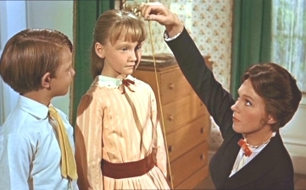
What does it measure?
basic openness
receptivity to different cultures, religions, and social practices;
the tendency (or not) to stereotype in particular ways;
self and emotional awareness;
preferred but implicit strategies for making sense of why ‘other’ people and cultures ‘do what they do’ (Shealy, 2005, p. 99).

Slide 53
How is the BEVI Used?
Evaluating Intervention Effectiveness
Understanding Processes of Change
Promoting Learning Objectives
Enhancing Teaching, Program and Intervention Quality
Facilitating Growth and Development
Conducting Research
Addressing Leadership and Organizational Needs
Complying with Assessment and Accreditation Requirements

Slide 54
How is the BEVI structured?
Formative Variables
•Negative Life Events
Fulfillment of Core Needs
•Needs Closure
•Needs Fulfillment
•Identity Diffusion
Tolerance of Disequilibrium
•Basic Openness
•Self Certitude
Critical Thinking
•Basic Determinism
•Socioemotional Convergence
Self Access
•Physical Resonance
•Emotional Attunement
•Self-Awareness
•Meaning Quest
Other Access
•Religious Traditionalism
•Gender Traditionalism
•Sociocultural Openness
Global Access
•Ecological Resonance
•Global Resonance
Notes:
Explain that they are empirically derived….and grounded...theory came from data.

Slide 55
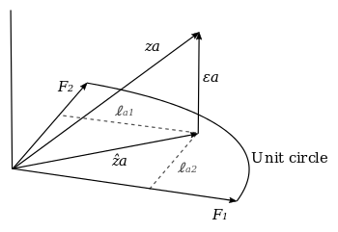
How is the BEVI structured?
The BEVI has undergone multiple exploratory and confirmatory factor analyses to determine and validate the structure that underlies BEVI items.
For those of you who are unfamiliar with factor analysis, a brief explanation can be found at
https://www.youtube.com/watch?v=Q2JBLuQDUvI.
Notes:
https://www.youtube.com/watch?v=UWP9OEoaNnE (just the first 5 minutes for your viewing pleasure)

Slide 56
Correlation Matrix Findings
Sociocultural Openness -- Other BEVI Scales
Needs Closure (-.90)
Ecological Resonance (.88)
Socioemotional Convergence (.82)
Basic Determinism (-.81)
Identity Diffusion (-.71)
Emotional Attunement (.77)
and other scales with correlations that are not quite as strong
Notes:
Long BEVI correlations - update with BEVI 3.0 norming data

Slide 57
Correlation Matrix Findings
Overall, individuals HIGH on Sociocultural Openness are:
More likely to indicate their needs were met
More likely to be concerned about the environment
Less likely to be polarized thinkers
Less likely to be in an identity crisis
More likely to value and be comfortable with emotional expression

Slide 58
Full Scale Scores
What is the BEVI Full Scale score?
A composite score that captures the core or essence of what the BEVI measures, including openness; receptivity to different cultures, religions, and social practices; the tendency to stereotype (or not) in particular ways; self and emotional awareness; and strategies for making sense of why other people and cultures do what they do (Wandschneider et al., 2015)
Has been used to operationalize the construct of global identity (Wang, 2018)
Includes 11 of the 17 scales
Derived both empirically – that is, based on correlation matrices and factor analyses – and theoretically - based on EI Theory
Where does the Full Scale score appear in the BEVI group reports?
Background Domain Contrast
Profile Contrast
Lowest Optimal Background Domain
Lowest Optimal Profile
Notes:
Lowest Optimal Background-Domain presents aggregated background information and domain scores for the 1st – 30th percentile of full scale scores. The full scale score is summative of scores from the seven domains of the BEVI under which the 17 process scales are clustered: 1) Formative Variables; 2) Fulfillment of Core Needs; 3) Tolerance of Disequilibrium; 4) Critical Thinking; 5) Self Access; 6) Other Access; and 7) Global Access (see www.thebevi.com). It is “key” to interpretation and intervention because this subgroup weights the bottom 30 percent of the overall group (i.e., this subgroup likely could benefit most from “change” in a direction that probably would be consistent with key goals of the learning, growth, or development experience in which such individuals are participating).

Slide 59
Guided Practice
Making Sense of BEVI Scales and Domains

Slide 60
How is the BEVI structured?
Identify the 3 scales that you feel you understand the best and explain them to a partner.
Identify the 3 scales that you have the most questions about and see if anyone else can help you understand them better.
Find 3 scales that you have a definite opinion about which end of the spectrum you “prefer” and see who agrees or disagrees with you.

Slide 61
Key BEVI Findings
Formative Variable
Mediator
Outcome
0.870
Negative life events
-0.212
-0.201
0.715
Ethnicity
0.219
0.519
-0.031
Sociocultural
Openness
Interest in Int’l Exp.
Family Income
0.063
Father’s education
0.875
0.838
0.118
-0.724
Mother’s education
p< .05
Χ²=5003.382, df=1211, p=0.000, RMSEA=0.054, CFI=0.934

Slide 62
Key BEVI Findings
Formative Variable
Mediator
Outcome
Negative life events
0.239
Ethnicity
0.044
Gender
Traditionalism
-0.174
0.044
GPA
Family Income
-0.092
Father’s education
-0.036
Mother’s education
p< .05
Χ²=1040.857, df=268, p=0.000, RMSEA=0.051, CFI=0.937

Slide 63
The Forum BEVI Project https://forumea.org/research-bevi-project/

Slide 64
The Forum BEVI Project
https://forumea.org/research-bevi-project/

Slide 65
The Forum BEVI Project
http://frontiersjournal.org/wp-content/uploads/2015/09/WANDSCHNEIDERetal-FrontiersXXV-TheForumBEVIProject.pdf

Slide 66
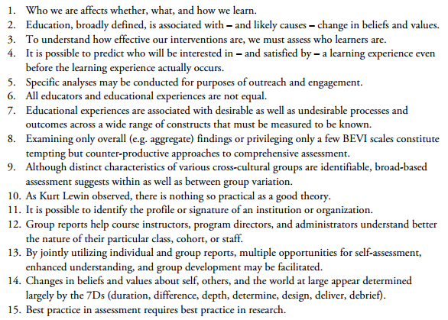
Forum BEVI Project Implications

Slide 67
Analyzing Results
Making Sense of BEVI Group Reports

Slide 68
Analyzing Reports
Work from more general to more specific as you take in the data. For example:
1) Consistency and Congruency Checks (reliability and validity)
2) Aggregate Profile (means) and Decile Profile (distributions)
3) Profile Contrasts by Demographics (subgroup variation by gender, ethnicity, etc.)
4) Profile Contrast and Background-Domain Contrast (subgroup variation by full scale score)

Slide 69
Analyzing Reports
Some questions to ask as you explore the data:
1) What overall picture of the group do the data paint?
2) What is was expected and unexpected about the data?
3) How is the group similar and different from others? Within itself? From itself over time?
4) What do the data suggest about the nature of the learning experience, student cohort, institution?
5) What do the results suggest should be modified?
6) What data should be highlighted as you explain these results to others? (i.e., What purposes do they serve? What questions do they answer?) What form should your report on the data take?

Slide 70
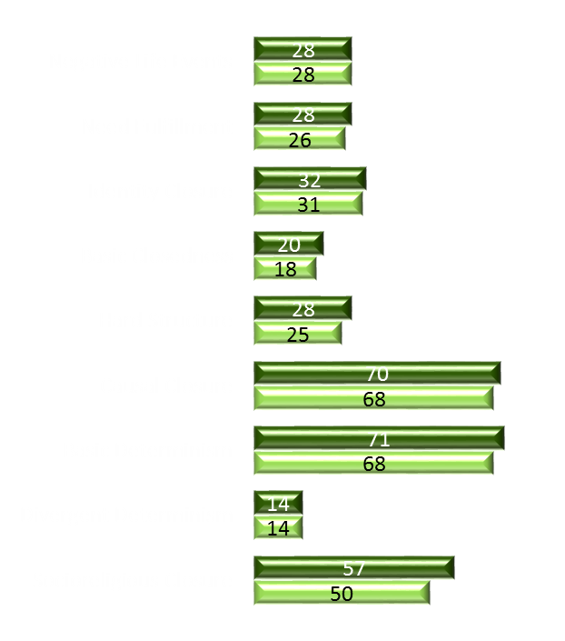
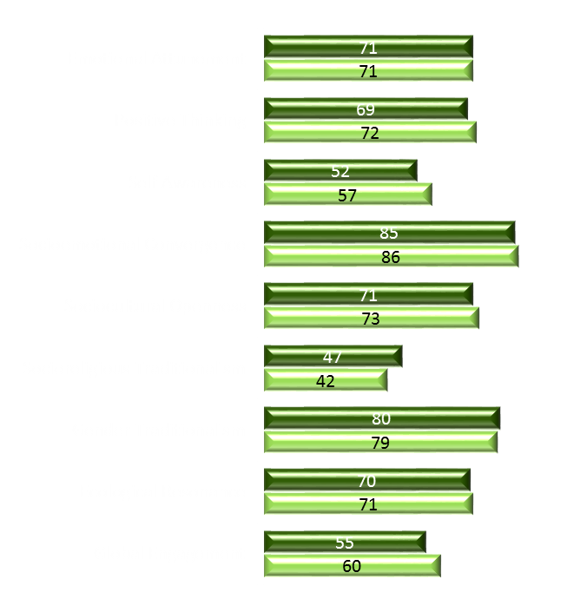
Sample Report Highlights
Institutional Profiles Tracked over Time
Low=strongly disagree - High=strongly agree
2010
2011

Slide 71
Sample Report Highlights
Profiles Compared across Institutions
Freshmen at a Highly Internationalized Liberal Arts College (N = 157)
Freshmen at a Technical University with Engineering Focus (N = 292)

Slide 72
Sample Report Highlights
Profiles Compared across Course Sections

Slide 73
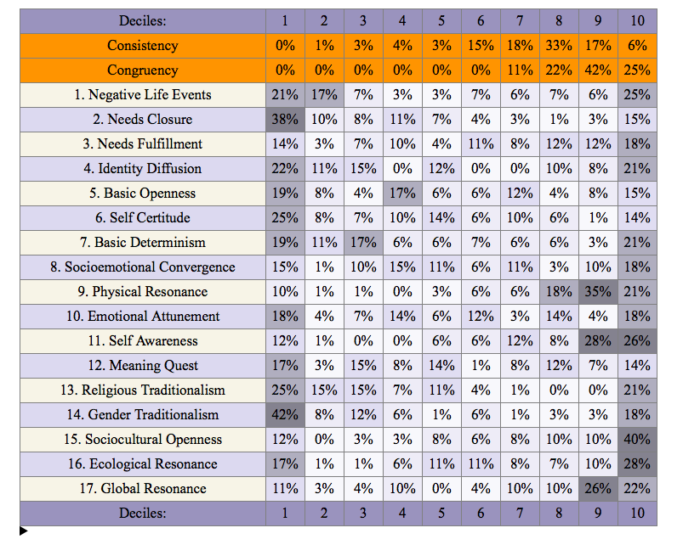
Sample Report Highlights
Formative Assessment of Scale Distributions
This was a multi-national group of students studying gender identity and transgender rights. Looking at the orientation toward gender within the group was helpful for faculty. It allowed them to identify areas of potential conflict and growth (note the bimodal distribution on many scales).

Slide 74
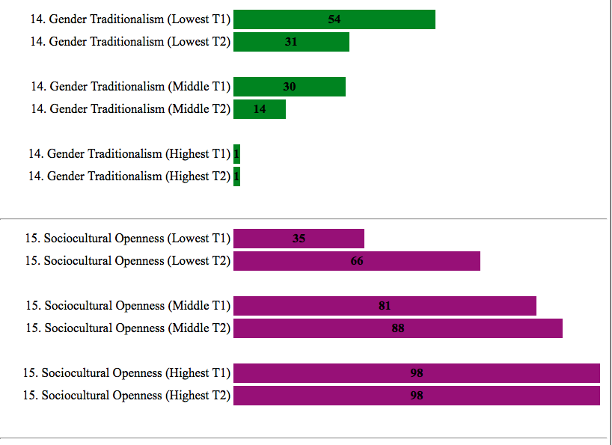
Sample Report Highlights
Program Evaluation using T1/T2 (Pre-/Posttest) Change
This is the same group of students from the decile profile, a multi-national group participating in an intensive seminar on Gender Identity and Transgender Rights. Note how more growth occurred where there was more room to grow, and that overall two important learning outcomes were achieved.

Slide 75
Sample Report Highlights
T3 (Delayed Posttesting) Longitudinal Assessment
Note the consistent pattern of regression in the short term and growth past pretest levels in the long term.

Slide 76
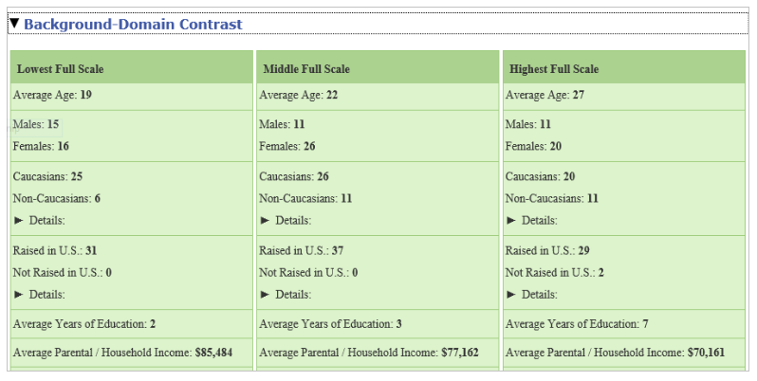
Sample Report Highlights
Profiles of Full Scale Score Groupings

Slide 77
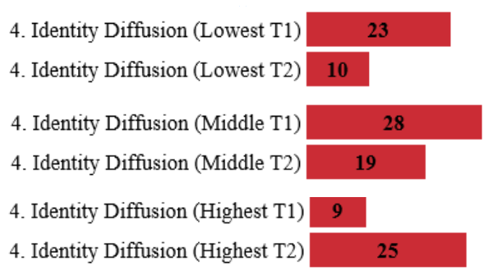
Sample Report Highlights
Scale Details of Full Scale Score Groupings
Aggregate Profile shows no change
Profile Contrast shows how each subgroup did in fact change (but these changes were in opposite directions and so cancelled each other out in the aggregate mean

Slide 78
Brain Break

Slide 79
Best Practices
Approaches and Strategies for Designing Assessments with the BEVI

Slide 80
Consider your System Logic
Notes:
Why do you expect your intervention to work?

Slide 81
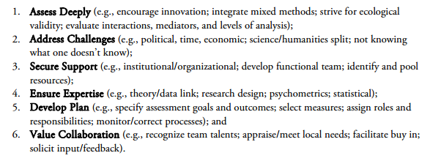
Recommendations for Collaborative Success
http://oia.osu.edu/presentations/2566-international-program-evaluation-the-power-of-collaboration.html

Slide 82
Tips on Administering the BEVI
Plan ahead (think about timing)
Provide brief description and usage for information (see one page blurb for students)
Try to anticipate future groups
Debrief in person when you can
Make sure your group knows what the BEVI is and why you are using it
Keep passwords secure
Identify what use the data will have before you deploy the instrument
Contact us (BEVI specialists) with questions
Notes:
Highlight that we can be a resource for those who will need more consultation and support

Slide 83
Tips on Language to Use in Debrief
Keep language neutral
Be transparent, make connections between learning objectives and BEVI scales
Avoid singling out one subgroup as the dysfunctional or ideal group
Using “optimal” as keyword to indicate greater likelihood of success of learning
Avoid defensive response, listen to participants, help them reframe
When you don’t know, get back to them
Notes:
Highlight that we can be a resource for those who will need more consultation and support

Slide 84
Administrator Access
Navigating the Two
BEVI Websites

Slide 85
Informational Website
https://www.thebevi.com
Explore BEVI applications
See current features and pricing structures
Get contact information
Find resources (e.g., manual, FAQ) and publications

Slide 86
Administrator Website
https://www.bevi-admin.com
Manage groups
Clean data
Check completion
Create reports
https://m.youtube.com/watch?feature=youtu.be&hd=1&v=AS8ulXij4zY

Slide 87
Administrative Website
https://www.bevi-admin.com
Manage Groups
Clean Data
Check Completion
Create Reports
https://m.youtube.com/watch?feature=youtu.be&hd=1&v=AS8ulXij4zY

Slide 88
Guided Practice
Analyzing Sample BEVI Reports

Slide 89
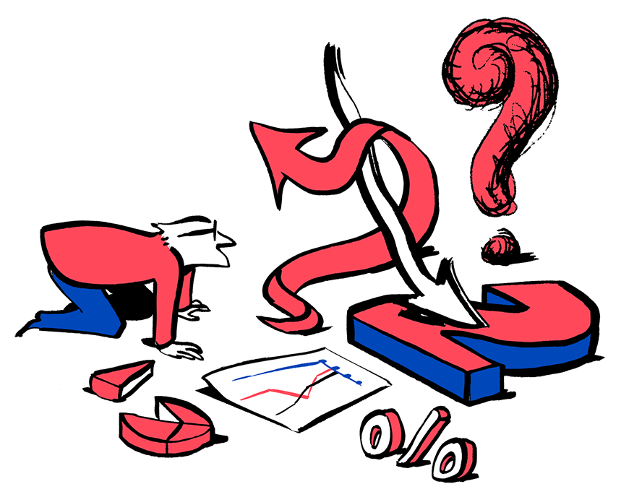
Get an Overview of the Data
First, check Consistency and Congruency scores - is the administration valid and reliable?
Next, glance at the Worldview Intensity and Worldview Shift - how strongly do people feel, and how much do group members disagree?
Analyze the Aggregate Profile and Deciles - what do you notice?

Slide 90
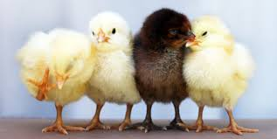
Find Patterns within the Group
Choose 2 Profile Contrasts by Demographic factors such as Gender, Ethnicity, Income, etc. Be sure to check the Ns to ensure generalizability.
What strikes you as interesting about the within group variation by demographics?

Slide 91
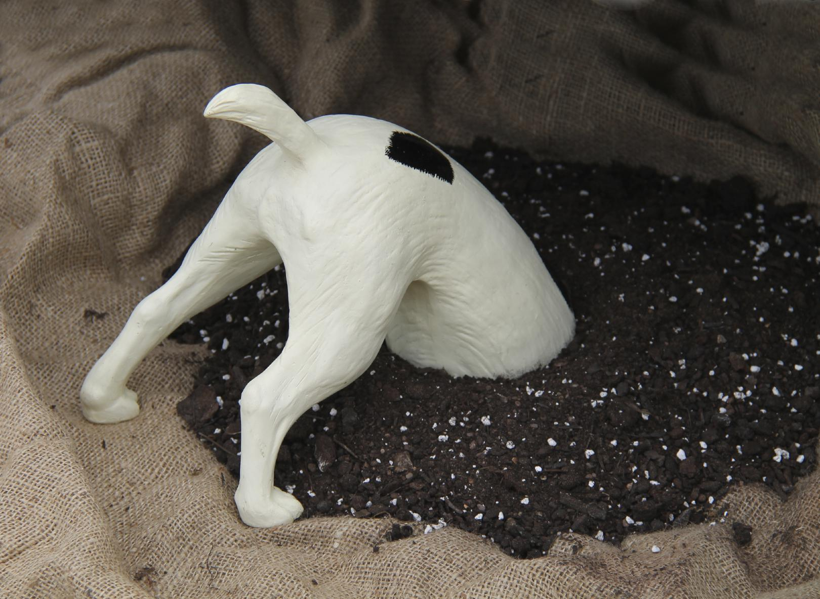
Dig Deeper: Subgroup Variation
Compare the Aggregate Profile to the Aggregate Profile Contrast - what insight does this breakdown offer?
Next, look at the Background Domain Contrast - T1 - how are the high, middle, and low full scale score groups different demographically?

Slide 92
Pedagogical Implications
The 7 D’s
Duration
Difference
Depth
Determine
Design
Delivery
Debriefing
(Wandschneider et al., 2015)

Slide 93
Next Steps

Slide 94
BEVI 3.0
Updated Norms
Unlimited Group Reports
New Group Reporting Features and Indices
T1/T2/T3 Group Comparisons
Internationalized Demographics
Automated Participant Reminders
T1/T2 Individual Narrative Reports

Slide 95
You Still Need To:
Explore the resource area of thebevi.com
Download the online manual when the revision becomes available (August)
Get an individual log-in for the admin website bevi-admin.com and practice downloading reports
Practice analyzing the BEVI - the goal is for you to become a self-sufficient BEVI administrator and analyst

Slide 96
Contact Information
Craig Shealy, PhD
craigshealy@gmail.com
Kris Acheson-Clair, PhD
kris.acheson@gmail.com
Jennifer Wiley, EdD
jjoneswiley@gmail.com

